Slide 1
Final Project Part 1: Three Problems
NFL Fantasy predictions
Facebook clusters
Political preferences

Slide 2
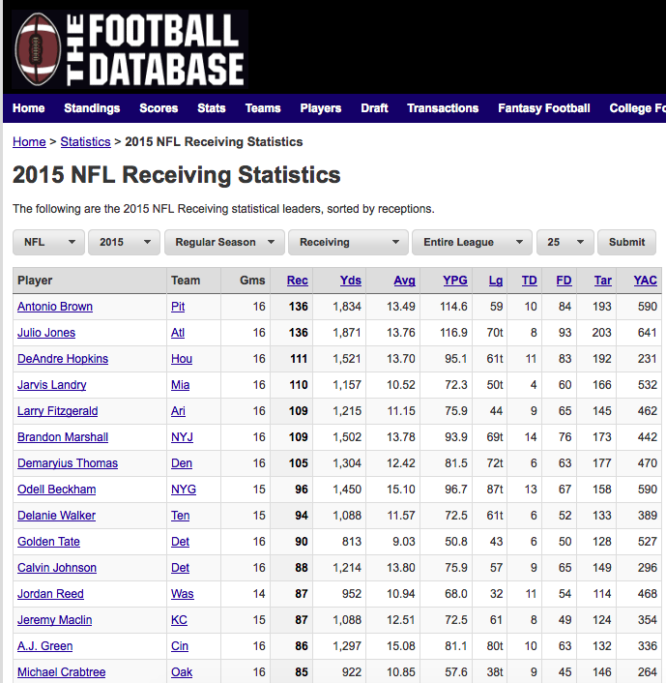
Predicting NFL Fantasy Results
Using NFL player statistics from 2000-2015, (footballdb.com, advancednflstats.com)
Associations between fantasy performance and 1) past weeks’ performance, 2) quality of teammates
Hypothesis: fantasy points is positively correlated with past fantasy points and with teammate quality
Notes:
Fantasy Sports is big business, bringing in 20-25 million a week
Player injury – what makes it help or hurt teammates?

Slide 3
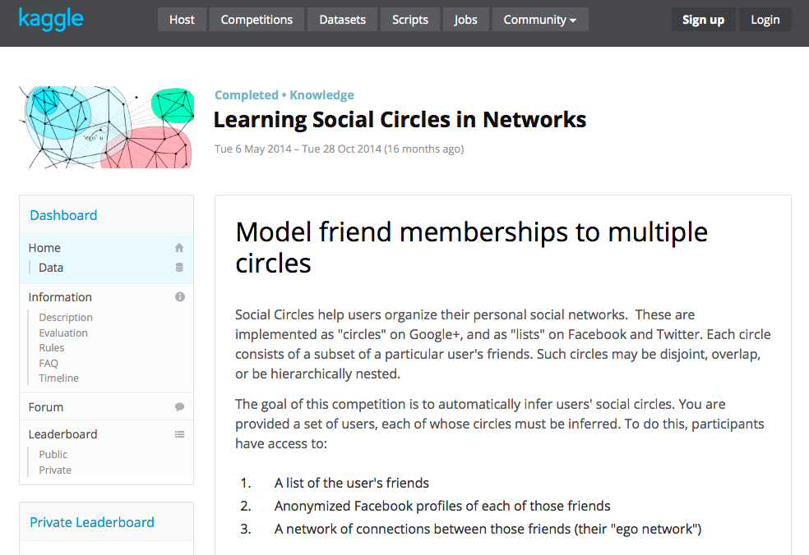
Predicting Cluster, Strength of FB Network
Notes:
Kaggle

Slide 4
Predicting Cluster, Strength of FB Network
Using Facebook data on friendships, political/religious views, likes, and shares
Explore factors that predict insularity (whether someone’s friends have mutual friends, shares are shared by friends, etc)
Hypothesis: Stronger religious and political views create “stronger” more insular network
Notes:
Marketing of social products, impression of political consensus

Slide 5
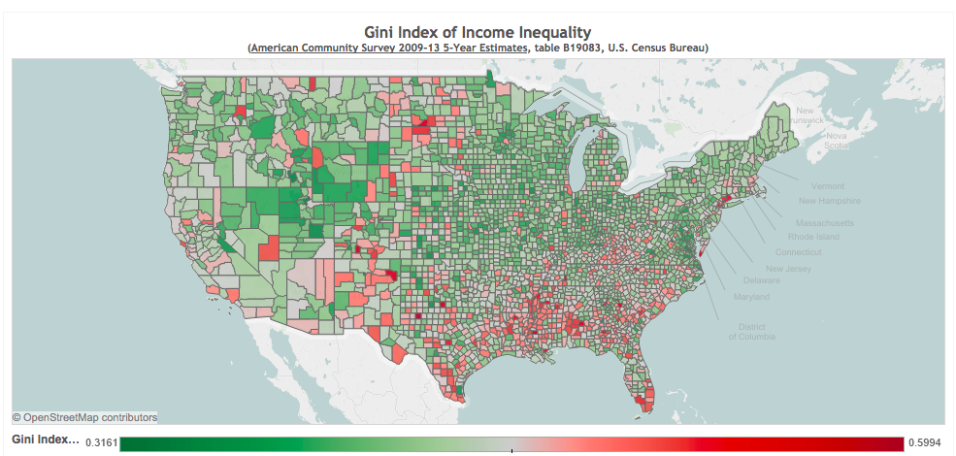
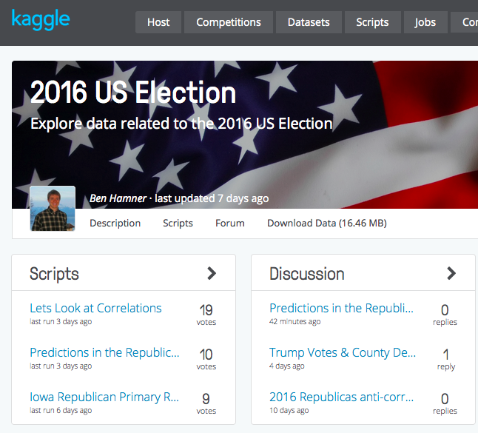
Predicting Political Support by Income, GINI

Slide 6
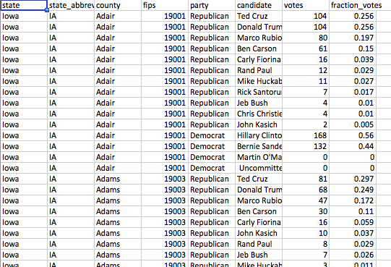
Predicting Political Support by Income Distribution
Using American Community Survey county-by-county income distribution and primary results from Kaggle
Associations between county’s income distribution (GINI, share of wealth in top 5%) and vote profile
Hypothesis: income distribution stronger predictor of votes in Democratic Primary than GOP Primary

